Slide 1
Database Development & Design
Introduction

Slide 2
Outline
  Definitions
  Data Vs. Information Examples
  Database
  Database Management System (DBMS)
  Relational DBMS
  Data Models

Slide 3
Definitions
Data: Data means raw facts gathered about someone or something, which is bare and random. The data can be:
  Structured: numbers, text, dates.
  Unstructured: images, video, documents.
Information: Information is described as that form of data which is processed, organized, specific and structured, which is presented in the given setting.
Metadata: Data that describes the properties and context of user data.
Information
Data
Metadata

Slide 4
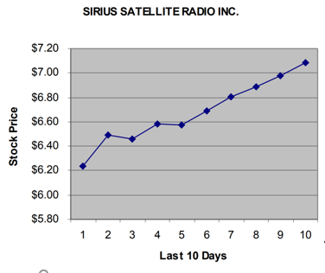
Data vs. Information
Data: 51007
Information:
  5/10/07 the date of your birth date.
  $51,007 the average starting salary of an accounting major.
  51007 the zip code of Bronson lowa.
Data:
  6.34
  6.54
  6.39
  6.62
  6.57
  6.64
  6.71
  6.82
  7.12
  7.06

Slide 5
What Is The Database?
A large collection of data stored in a well-defined structure
Database is an organized collection of logically related data
You can think of a database as:
  An electronic filing system
  A repository for large amounts of information
Example of a paper database
  Telephone book
Examples of computer databases
  HTU stores student information in a database
  Insurance companies store policy holder information in a database
  Your employer stores your information in a database
  Your electricity service provider uses a database to manage billing, client-related issues, handle fault data, etc.
  Facebook. It needs to store, manipulate, and present data related to members, their friends, member activities, messages, advertisements, and a lot more

Slide 6
Types of Databases
Traditional Data:
  Numeric and Textual Databases
More Recent Data:
  Multimedia Databases
  Geographic Information Systems (GIS)
  Biological and Genome Databases
  Mobile databases
  Real time and Active Databases

Slide 7
Database
Central repository of shared data.
Data is managed by a controlling agent.
Stored in a standardized, convenient form.
No redundant data.
Data consistency because of the process of normalization.
Security.
This requires a Database and Database Management System (DBMS)

Slide 8

Advantages of Database Approach
Library
Examination
Registration
Library
Applications
Examination
Applications
Registration
Applications
Database
Management System
Data Sharing
Controlled Redundancy
University
Students Database
Data Independence
Better Data Integrity

Slide 9
Database Management System
DBMS stands for Database Management System.
Database Management System is basically software that manages the collection of related data. It is used for storing data and retrieving the data effectively when it is needed.
What is the need of DBMS (Functionality):
  Define a particular database in terms of its data types, structures, and constraints
  Construct or Load the initial database contents on a secondary storage medium
  Manipulating the database:
    Retrieval: Querying, generating reports
    Modification: Insertions, deletions and updates to its content
    Accessing the database through Web applications
    Processing and Sharing by a set of concurrent users and application programs – yet, keeping all data valid and consistent
Additional DBMS Functionality
  Protection or Security measures to prevent unauthorized access.
  Presentation and Visualization of data.
  Maintenance of the database.

Slide 10

Advantages of DBMS
Controlling Data Redundancy
Sharing of Data
Data Consistency
Integration of Data
Integration Constraints
Data Secure – Each user has a different set of access
Restricting unauthorized access to data. Only the DBA staff uses privileged commands and facilities.
Data Atomicity (An atomic transaction is an indivisible and irreducible series of database operations such that either all occurs, or nothing occurs. )
Control Over Concurrency
Backup and Recovery Procedures
Providing Storage Structures (e.g., indexes) for efficient Query Processing.
Notes:
procedure of managing simultaneous operations without conflicting with each other

Slide 11
Relational Database Management System (RDBMS)
RDBMS stands for relational database management system.
RDBMS is a database management system (DBMS) that is based on the relational model.
The data in RDBMS is stored in database objects called tables.
A table is a collection of related data entries, and it consists of columns and rows.
RDBMS is a program that lets you create, update, query and administer a Relational database.
RDBMS is the basis for SQL, and for all modern database systems like MS SQL Server, IBM DB2, Oracle, MySQL, and Microsoft Access.
RDBMS provides consistency, integrity and security of the data it holds and as such the reliability and robustness of the relational database it looks after.

Slide 12
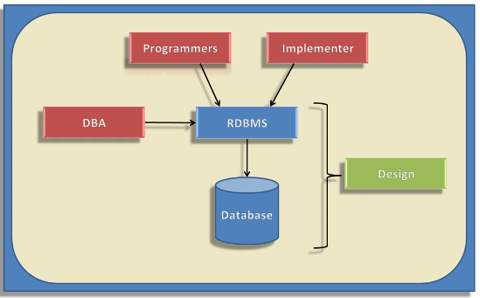
Relational Database Management System (RDBMS)

Slide 13
Data Models
A Data Model is a logical structure of Database. It describes the design of database to reflect entities, attributes, relationship among data, constrains etc.
Data Models Types:
Object based logical Models – Describe data at the conceptual and view levels.
  Entity Relationship model (ER model; To be discussed through the semester)
  Other Models:
  Object oriented Model
  Hierarchical Model
  Network Model
  Graph Model
  Document Model

Slide 14
Relational database Vs. object-oriented database
Criteria | Relational Database | Object Oriented Database
Definition | Data is stored in tables which consist of rows and columns. | Data is stored in objects. Objects contain data.
Type of data | Relational database has single type of data. | It can handle different types of data.
How data is stored | Data is stored in the form of tables (having rows and columns). | Data is stored in the form of objects.
Data Manipulation Language (DML) | DML is as powerful as relational algebra. Such as SQL, QUEL and QBE. | DML is incorporated into object-oriented programming languages, such as C++, C#

Slide 15
References
Elmasri, R., & Navathe, S. (2017). Fundamentals of database systems (Vol. 7). Pearson
Eng. Lina’s slides
Dr. Raneem’s slides.

